Slide 1
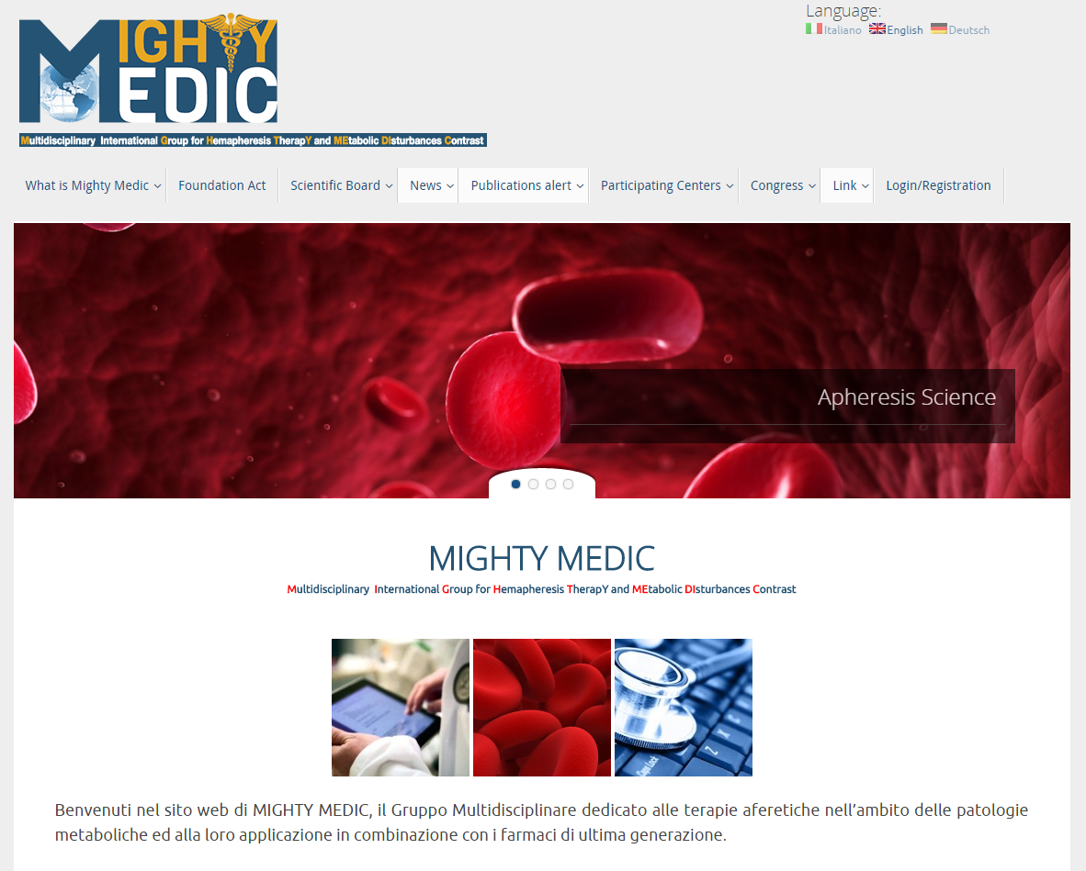

Slide 2
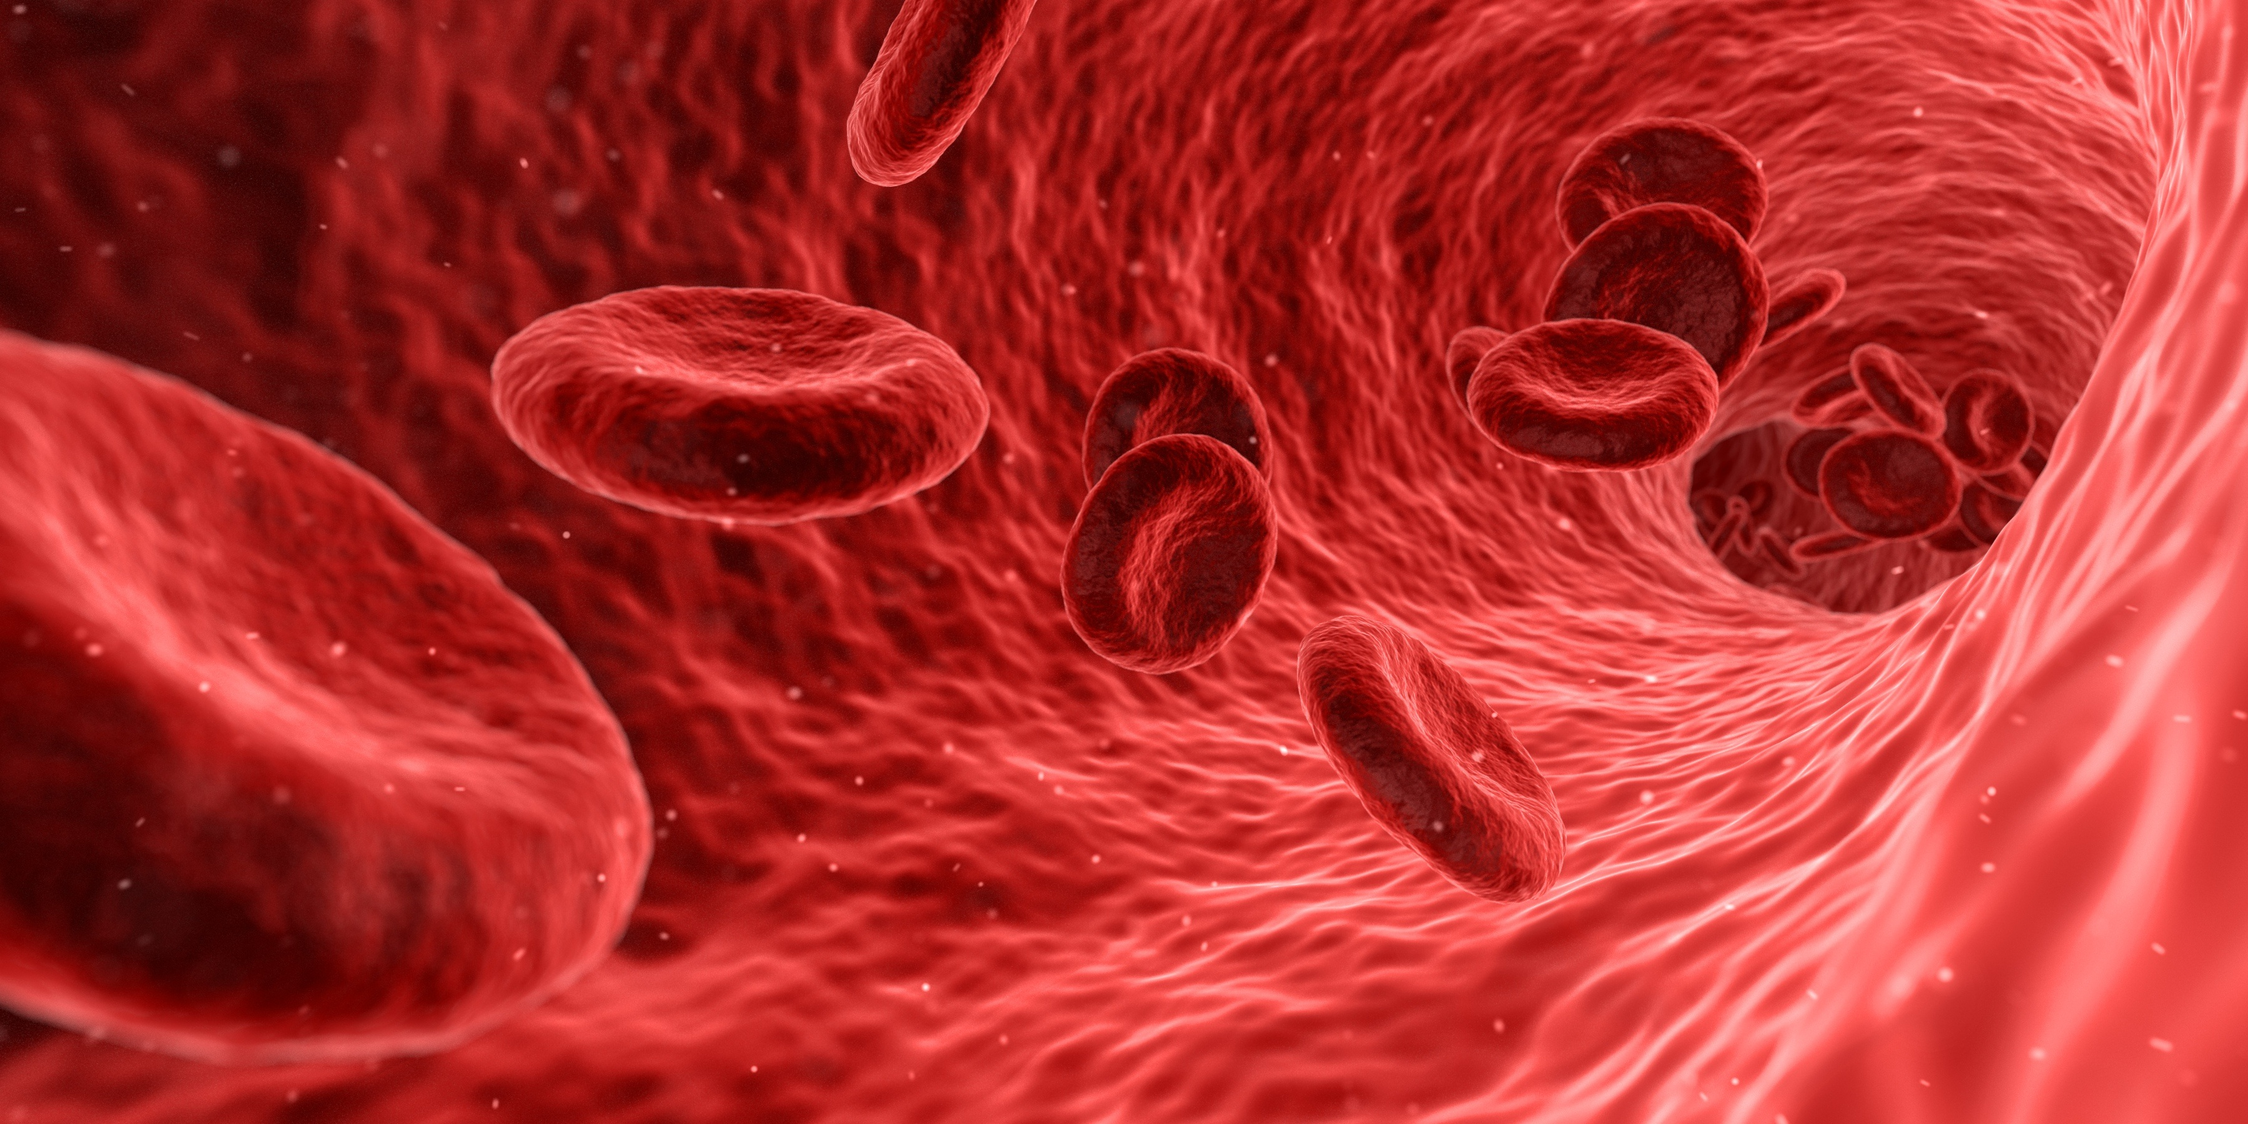

The Mighty-Medic network
Ulrich Juliusª, Claudia Stefanutti^{b}
ª Lipidology and Lipoprotein-Apheresis Center,
Department of Internal Medicine III, University Hospital at the Technische Universität Dresden, Germany
^{b} Head of Extracorporeal Therapeutic Techniques Unit
Lipid Clinic and Atherosclerosis Prevention Centre
Regional Centre for Rare Diseases
Immunohematology and Transfusion Medicine
‘Umberto I’ Hospital
Department of Molecular Medicine
‘Sapienza’ University of Rome

Slide 3
Legal status and purpose of MM
Legal private scientific association under the Italian Regulation, founded in 2013
To develop research papers, position papers, international consensus papers, educational meetings, summer schools, joint programs to raise funds from International financing bodies
The MM Scientific Society will closely collaborate with ISFA, ASFA, EAS, IAS and national societies (Italian Soc. of Nephrology; Italian Soc. for Hemapheresis in Italy; Lipid-Liga in Germany; UK-Heart in England; Patient Organizations)
Close cooperation with pharma and medical device companies with mutual respect, also in order to pursue common interests, both scientific and commercial

Slide 4








MIGHTY MEDIC – NATIONAL COORDINATORS
Multidisciplinary International Group for Hemapheresis TherapY and MEtabolic DIsturbances Contrast
ITALY and Central Coordination:
Prof. Claudia Stefanutti
SWEDEN:
Dr. Stefano Romeo
GERMANY:
Prof. Ulrich Julius
SERBIA:
Prof. Bojko B. Bjelakovic
THE NETHERLANDS:
Dr. Jeanine E. Roeters van Lennep
GREECE:
Prof. Euridiki Drogari
UK:
Dr. Handrean Soran
USA:
Prof. Patrick M. Moriarty
AUSTRIA:
Prof. Kurt Widhalm
AUSTRALIA:
Prof. Gerald F. Watts
FRANCE:
Dr. Samir Saheb
JAPAN:
Dr. Mariko Harada-Shiba

Slide 5
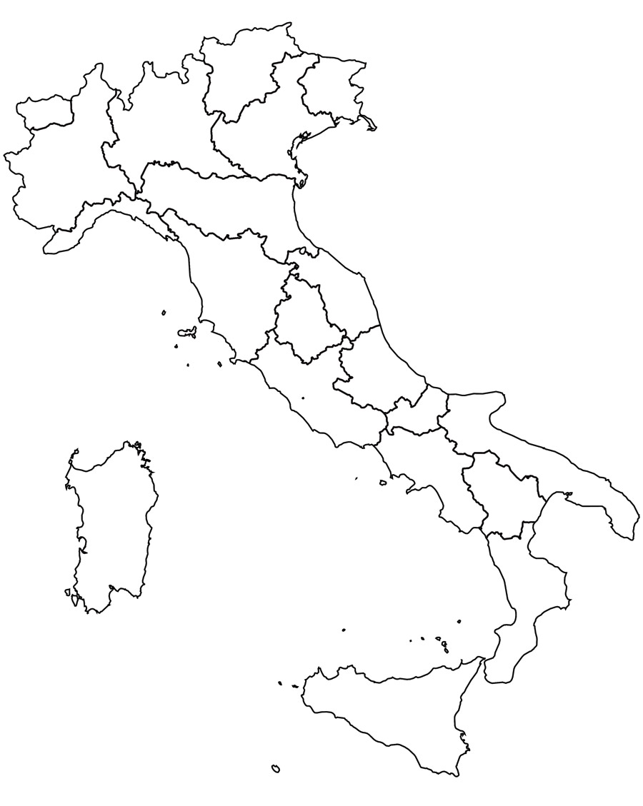


PADOVA
GALLARATE
MILANO
ORBASSANO
MESTRE
FORLÌ
GENOVA
REGGIO E.
PISTOIA
SIENA
VITERBO
OLBIA
BARI
SASSARI
ROMA
AVELLINO

Slide 6
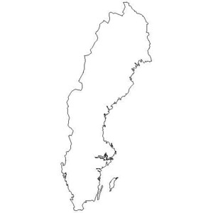
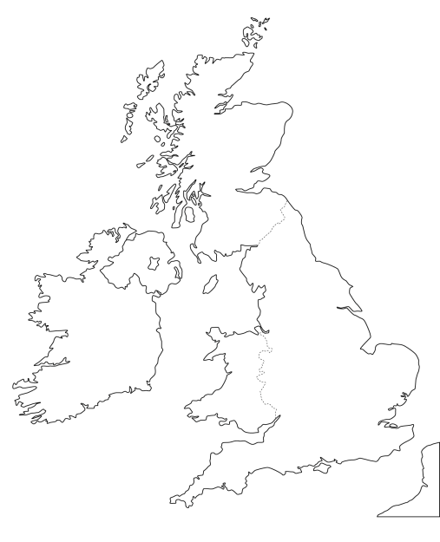
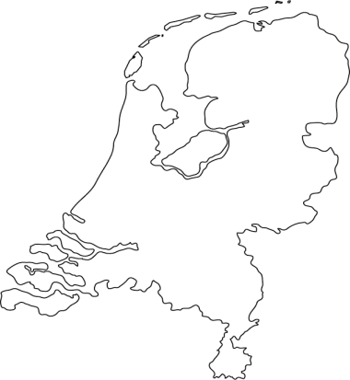

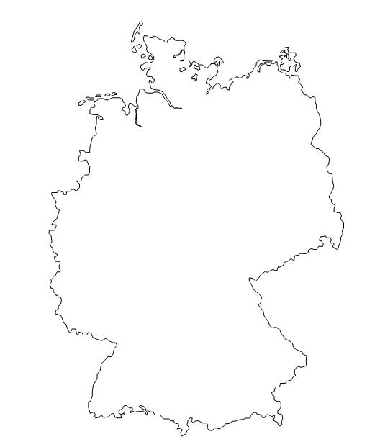




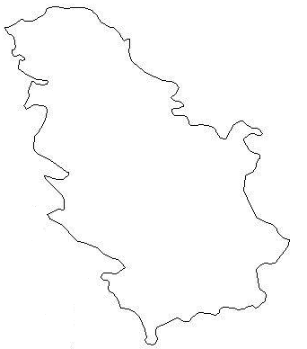


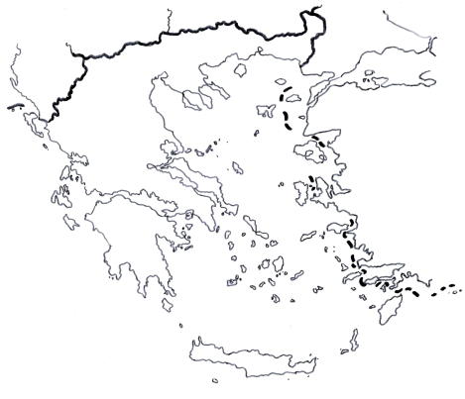


ROTTERDAM
FLENSBURG
GöTEBORG
MANCHESTER
LÜbeck
GöTtingen
DRESDEN
NIŠ
MÜLHEIM AN DER RUHR
PARIS
ATHENS
VIENNA

Slide 7

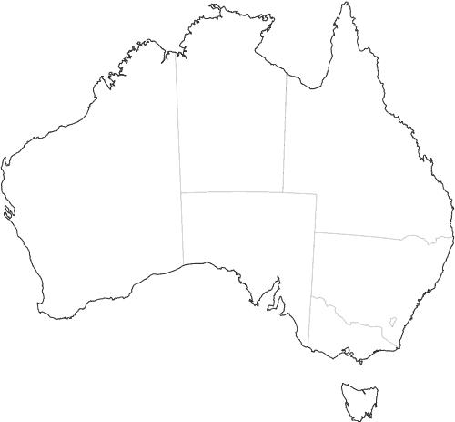
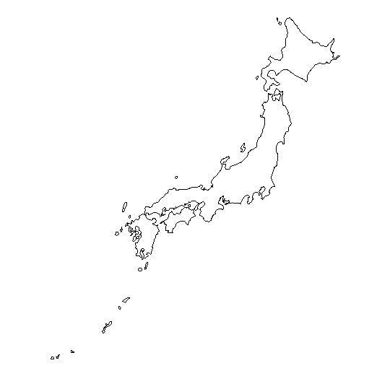


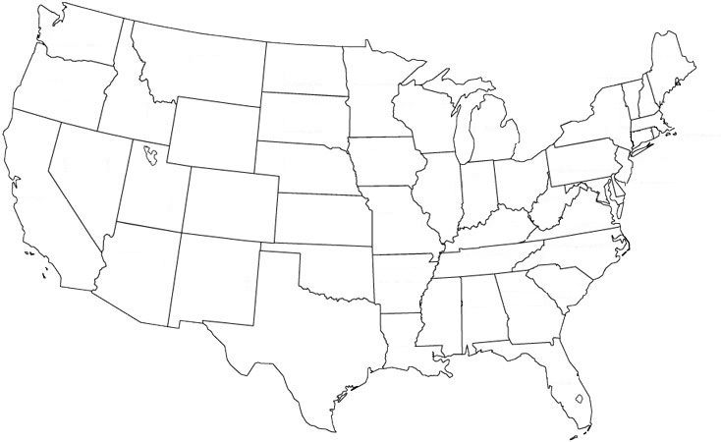


PERTH
OSAKA
KANSAS CITY

Slide 8

MIGHTYMEDIC – DEVELOPMENT AREAS
Support appropriate use of new technologies and faciltate access to new therapies
Institutional partner to reach public health targets
THERAPY MODEL
COLLECTIVE HEALTH
Generating specific knowledge and contributing to improve clinical practice
Contribute to define/ propose therapies golden standard based on acquired or being acquired knowledge/ experiences
KNOWLEDGE
Contribute to patient education (awareness)
Contributing to improve abilities and competences (relational, administrative, managing)

Slide 9

mighty medic
1 st survey
2013
9th LIPIDCLUB & Therapeutic Apheresis 2014 Giovanna D’Alessandri

Slide 10
general remarks
21 questions
someone of these multiple choices
3 / 21 free answers
23 centres had answered filling up the survey online:
https://www.surveymonkey.com/s/2LGVKGR

Slide 11
what are the basic therapies used for hyperlipoproteinAEmia in your centRE
answers = 21
16
16
8
10
2
13
10
19

Slide 12
did your CENTER EVALUATE ANY OF THE FOLLOWING NEW HYPOLIPIDEMIC DRUGs
answers = 8

Slide 13
IS Lp(a) ACTUALLY MEASURED IN HIGH RISK PATIENTS IN YOUR INSTITUTION ?
answers = 21

Slide 14
IF NOT MEASURED,
WHAT IS THE MAIN REASON FOR ?
answers=10
1
2
4
1
0
2

Slide 15
Does your hospital/clinic currently provide selective lipoprotein apheresis ?
answers = 21
13
8

Slide 16
WHICH INTERNATIONAL GUIDELINES ARE APPLIED IN YOUR HOSPITAL/INSTITUTION TO START lipoprotein apheresis ?
answers = 19
2
4
9
3

Slide 17
How many patients are actually treated by lipoprotein apheresis in your institution ?
answers = 16
Min 0 patients
Max 90 patients
St. Dev. 22.6 patients
Average 11.9 patients
Median 4.5 patients
institutions patients
4 0
3 2
1 4
1 5
2 6
1 7
1 11
1 27
1 28
1 90
patients = 180

Slide 18
In your opinion, how many patients would need lipoprotein apheresis in your institution, according to followed guidelines ?
answers = 12
Min 0 patients
Max 150 patients
St. Dev. 37 patients
Average 18.8 patients
Median 3 patients
institutions patients
2 0 ( children only)
2 2
1 4
1 8
1 10
1 25
1 27
1 30
1 150

Slide 19
what is the average frequency of the treatment for lipoprOtein apheresis in your institution ?
answers = 14

Slide 20
which technologies are available for the procedure ?
answers = 13

Slide 21
what are the reasons ( explaining why) patients started, but later decided to discontinue selective lipoprotein apheresis ? Check all that apply
answers = 11
5
4
2
2
1
2
3

Slide 22
did you decide at any time to submit your patients to:
answers = 11

Slide 23
DISCUSSION 1
Interestingly, the so called novel lipid lowering drugs are prescribed in 8 centers. It should be furtherly investigated if the above mentioned drugs are given with or without apheresis
Too many centers do not use selective techniques for lipid and lipoprotein apheresis ( 38%)
In general the national guidelines are followed. However, it is presumable that, for different reasons , lack of time, unavailability of selective apheresis techniques, poor referral from the other clinicians (cardiologists, etc.) some centers are not very active

Slide 24
DISCUSSION 2
In most of the centers LA might be given to a larger number of subjects. Unfortunately, this is not the case for several patients deserving this kind of treatment
The guidelines in term of clinical indication of LA are not fulfilled because of:
  lack of reimbursement at local or national level
  unspecified

Slide 25
DISCUSSION 3
In general, the interval between apheresis sessions is 7-15 days However, in some centers the treatment is individualized
As far as the selective methods of LA are concerned, the figures obtained from the survey suggest a substantial balance between the main available technologies
Discontinuation of LA appears to be mainly related to local and individual (personal) reasons. This issue should be furtherly investigated, along with the reason for poor compliance

Slide 26
DISCUSSION 4
LA is available, effective and reasonably safe, the novel lipid lowering agents are currently investigated (phase II / III clinical trials) actively or are already approved in some countries.
A combined treatment might be foreseen or at least might be probable. This will be, auspiciously, the real promise for the future.

Slide 27
MIGHTYMEDIC – MAIN IMMEDIATE PROJECTS
International Consensus (position) Paper on Lipoprotein Apheresis – Previous and Novel Indications - Integrating evidence on the extracorporeal treatment in combination with novel lipid-lowering drugs
International Lipoprotein Apheresis Registry

Slide 28
MIGHTYMEDIC – MAIN IMMEDIATE PROJECTS
Everybody who is interested in joining MM is invited to do so and will be welcome
An international active cooperation in the field of Lipoprotein- Apheresis is really urgently needed

Slide 29
MIGHTYMEDIC – NEW WEBSITE http://www.mightymedic.org/

