Slide 1
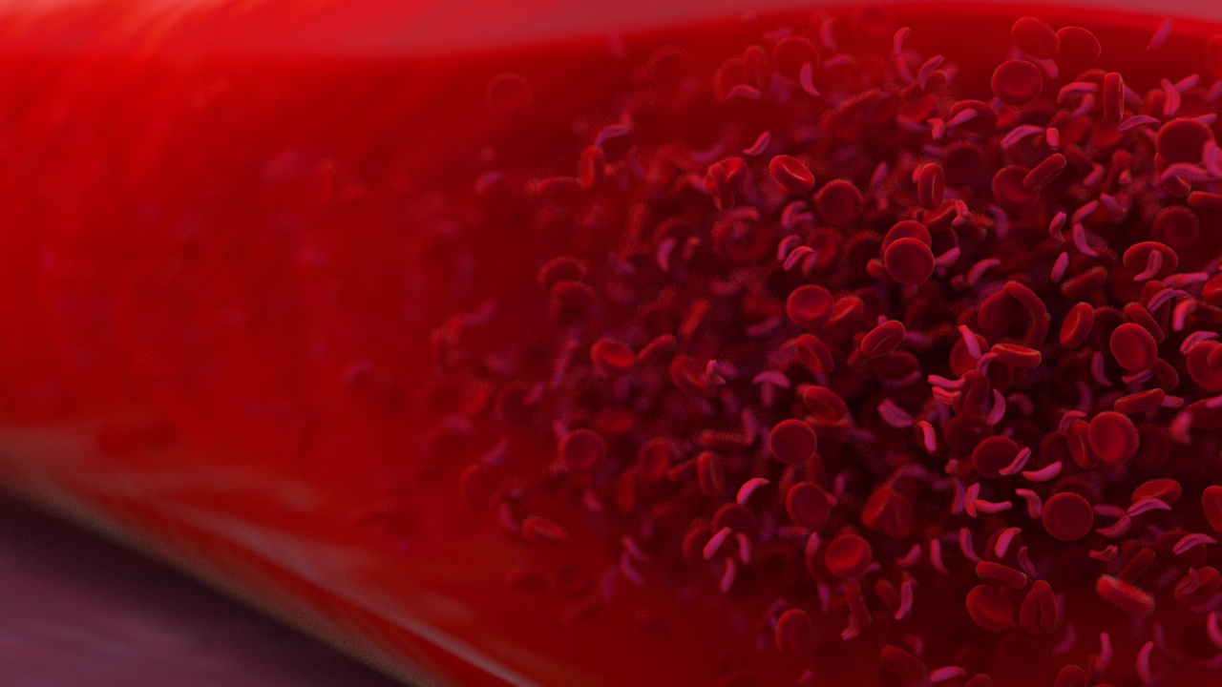
EMOREOLOGIA E MICROCIRCOLO
Prof.ssa CLAUDIA STEFANUTTI
ISS Roma, 2012

Slide 2
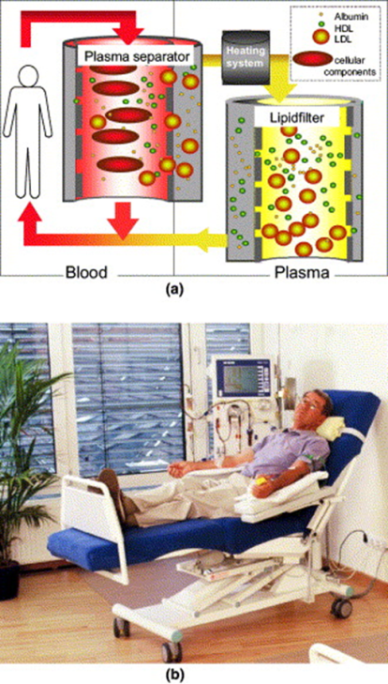
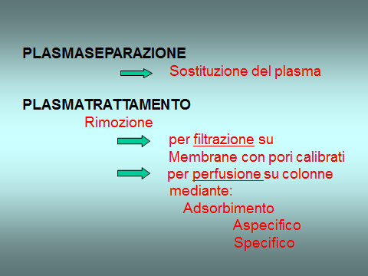
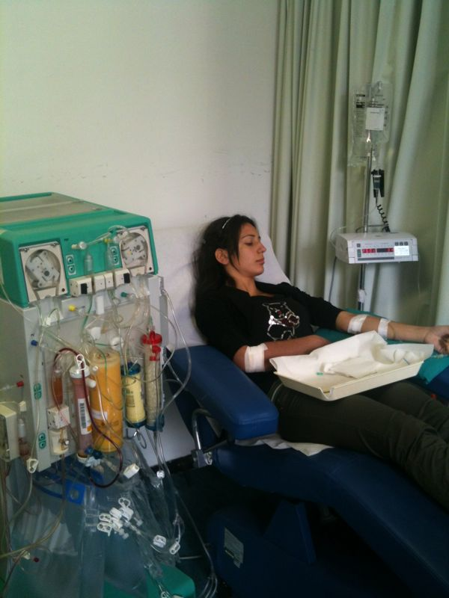
Le tecniche di aferesi terapeutica, convenzionali (PEX), semiselettive (FC), selettive (adsorbers, immunoadsorbers, precipitation, whole blood), inducono profonde modificazioni delle concentrazioni delle proteine plasmatiche, modificando le proprietà reologiche del sangue e la microcircolazione, alterando inoltre la composizione qualitativa di alcune proteine plasmatiche che esercitano un ruolo nei meccanismi di attivazione dell’endotelio arterioso e dei processi flogistici ed immunologici correlati

Slide 3
Selective pheresis
IN selective pheresis PROCEDURES, SPECIFIC ELEMENTS ARE ISOLATED FROM THE PLASMA AND DISCARDED, THEREBY ELIMINATING THE NEED TO REPLACE THE PLASMA.
Extracorporeal immunoadsorption
IN WHICH CIRCULATING IMMUNE COMPLEXES (CICs) ARE REMOVED FROM THE CIRCULATION AS A TREATMENT OF idiopathic thrombocytopenic purpura (ITP) AND rheumatoid arthritis.

Slide 4
Low Density Lipoprotein apheresis: IN WHICH LDL PARTICLES ARE
SELECTIVELY REMOVED FROM THE PLASMA AS A TREATMENT
OF familial hypercholesterolemia
A selective pheresis PROCEDURE IS ALSO A COMPONENT OF collection of bone marrow stem cells IN ANTICIPATION OF HIGH DOSE CHEMOTHERAPY AND EITHER AUTOLOGOUS OR ALLOGENIC STEM CELL SUPPORT.

Slide 5
Indicazioni della LDL-aferesi
FH omozigote e Compound
FH eterozigote refrattaria/intollerante alle terapie convenzionali
Iperlipoproteinemia Lp(a) > 60 mg/dL associata a CHD
Vasculopatia post-trapianto cardiaco CAV-GVD
Prevenzione stenosi precoci post CABG
Perdita improvvisa dell’udito (SHL) (H.E.L.P.)
Altre indicazioni, supportate da pubblicazioni di studi e casi clinici,
includono: le sindromi coronariche acute, lo stroke, la neuropatia
ottica ischemica, la PAOD, la sindrome nefrosica
Stefanutti C. The 2009 2nd Italian Consensus Conference on LDL-apheresis
Nutr Metab Cardiovasc Dis. 2010 Dec;20(10):761-2. doi: 10.1016/j.numecd.2010.04.007.

Slide 6
by courtesy of Thomas Bosch

Slide 7
% Reduction of LDL-C, HDL-C, Factor V, VII, VIII
Procedure | Volume treated | LDL-C (%) | HDL-C (%) | Factor V (%) | Factor VII (%) | Factor VIII (%)
IMA | 6,2 l | -(60-84%) | -(14-22%) | - 28% | - 28% | - 72%
DSA | 4,9 l | -(57-84%) | -(8-11%) | - 74% | - 30% | - 99%
HELP | 3 l | -(59-67%) | -(5-17%) | - 63% | - 36% | - 57%
DALI | 6,8-9,4 l* | - 77% | -13% | - 68% | - 4 % | - 60%
Lipocollect 200 § | 5,5 l | -(64-71%) | -26% | -71% | -18% | -71%
* whole blood while the others means serum
§ Stefanutti C.et al. (2009):LDL-apheresis: a novel technique (LIPOCOLLECT 200 ®)
Artif Organs. 33(12):1103–1108.

Slide 9
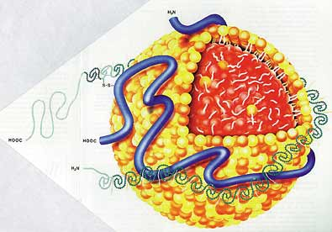
Effetti acuti del trattamento
H.E.L.P. sul fibrinogeno ed Lp(a)
Fibrinogeno Lp(a)
(mg/dl) (mg/dl)
prima 308 59
54%
46%
dopo 142 32

Slide 10
BACKGROUND
Rubba | 1990 | Circulation | Modificazioni emodinamiche in PVD dopo ripetute LDLa
Rubba | 1993 | Stroke | Modificazioni del flusso in CVD e cute dopo ripetute LDLa
Tamai | 1997 | Circulation | Vasodilatazione coronarica con acetilcolina dopo singola LDLa
Mellwig | 1998 | Atherosclerosis | Aumento del 30% della vasodilatazione coronarica dimostrata con PET 24 dopo singola LDLa
Kizaki | 1999 | Blood Coagul Fibrinolysis | Aumento del nitrossido in PVD dopo singola LDLa

Slide 11
LDL- Aferesi
Fibrinogeno |  | ICAM |  | MCP-1 | IA
VCAM |  | ELAM |  | Selectine
ELAM |  | MCP-1 | DX
MCP -1 |  | PCR |  | PCR | Poliacrilato
MCP -1 | HELP | Selectine |  | Fibrinogeno
PCR
Tissue factor
Endotelina-1
Selectine
Omocisteina
Courtesy: Giustina De Silvestro, M.D.

Slide 12
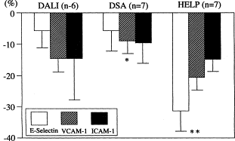
Clinical applications of long-term LDL-apheresis on and beyond refractory hypercholesterolemia
Hiroshi Mabuchi et al Transfusion and Apheresis Science Volume 30, Issue 3, June 2004, Pages 233–243

Slide 13
LDL-aferesi con sistema H.E.L.P.
Effetti dimostrati:
riduzione C-LDL (62%), oxLDL (47%), Lp(a) (56%), fattore Willebrand (57%), fibrinogeno (58%), e PCR (65%)
rimozione molecole di adesione ICAM (15.5%), VCAM (29.1%), P-selectin (26.0%), E-selectin (24.0%)
riduzione della viscosità plasmatica: 19%
riduzione dell’aggregazione eritrocitaria: 60%
Impatto sulla funzione endoteliale e sulla microcircolazione
1. BR Jaeger et al. Ther Apher Dial, 2003; 7(4): 391-396; 2. KP Mellwig et al. Ther Apher Dial, 2003; 7(3): 365-369

Slide 14
Effetto pleiotropico della H.E.L.P.- LDL- aferesi sulla funzione endoteliale e sulla microcircolazione
La contemporanea drastica rimozione ottenuta con H.E.L.P.- LDL- aferesi di LDL, Lp(a), fibrinogeno, fattore Willebrand, PCR, ICAM, VCAM, P-selectin ed E-selectin:
favorisce un riequilibrio della funzione endoteliale e quindi dell’omeostasi vascolare (vasodilatazione a seguito di una maggiore bio-disponibilità di NO)
contrasta l’azione degli agenti protrombotici (immediato miglioramento dei parametri emoreologici).
1. BR Jaeger et al. Ther Apher Dial, 2003; 7(4): 391-396; 2. KP Mellwig et al. Ther Apher Dial, 2003; 7(3): 365-369

Slide 15
Perfusione miocardica dopo H.E.L.P. LDLa valutata mediante PET
Dip di Cardiologia dell’Università di Bochum: H.E.L.P.-aferesi in # 35 Hyperch. + CHD. Mediante PET dinamica quantitativa effettuata prima dell’H.E.L.P.- LDL- aferesi e dopo 18-20 ore, sia a riposo che con vasodilatazione indotta da dipiridamolo:
La H.E.L.P.- LDL- aferesi determina dopo 20 ore dal trattamento un incremento delle capacità vasodilatativa coronarica del 20%.
flusso coronarico | 177 | 217 | p<0.0001
riserva coronarica | 2.10 | 2.62 | p<0.0001
resistenza coronarica minima | 0.56 | 0.44 | p<0.0001
(*) Heparin-induced Extracorporeal Low-density Lipoprotein Precipitation Mellwig KP. (Ther Apher and Dial 2003)

Slide 16
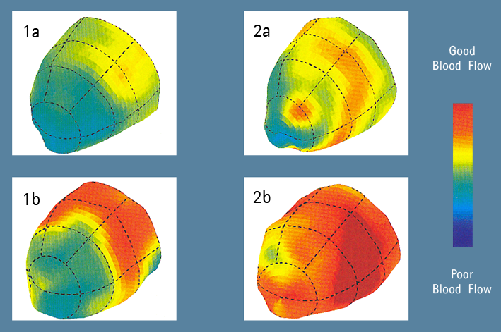
Flusso coronarico (CBF) dopo H.E.L.P.- LDL-aferesi. Valutazione mediante PET
Basale
Dopo 9 mesi di terapia H.E.L.P.
CBF prima di terapia H.E.L.P.
CBF 20h dopo terapia H.E.L.P.
Mellwig KP et al. Z Kardiol. 2003, 92 Suppl. 3:III30-III37

Slide 17
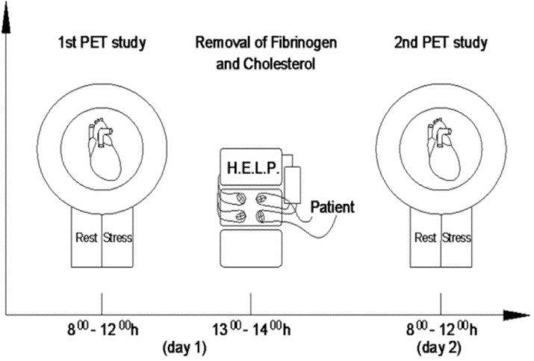
Myocardial blood flow at rest and during adenosine-induced hyperemia was measured using (13)N-ammonia in # 10 patients
Changes in Myocardial Vasoreactivity After Drastic Reduction of Plasma Fibrinogen and Cholesterol: a Clinical Study in Long-term Heart Transplant Survivors Using Positron Emission Tomography Beate R. Jaeger et al The Journal of Heart and Lung Transplantation Volume 24, Issue 12, December 2005, Pages 2022–2030

Slide 18
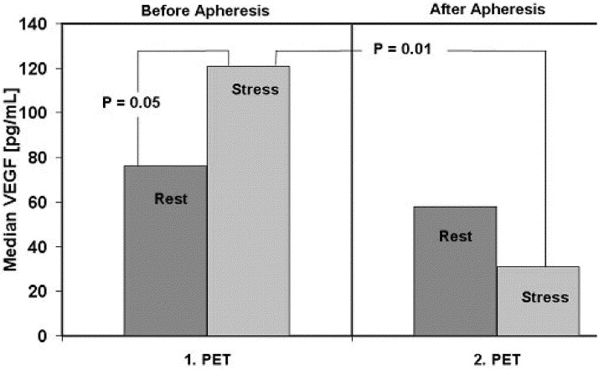
HELP-LDLa reduced LDL-C, Lp(a) and CRP by 48% (p < 0.001), F by 42% (p = 0.02), plasma viscosity by 14% (p = 0.004) and erythrocyte aggregation by 28% (p < 0.02). Osmolality (<1%) and hematocrit (<2%) remained stable. A single apheresis treatment increased median corrected rest flow by 17.5% (p = 0.007) and median hyperemic flow by 27% (p = 0.02). Median coronary flow reserve increased by 8.1% (p = 0.09). Hyperemic flow after adenosine infusion increased plasma vascular endothelial growth factor levels only before HELP-apheresis (+60%), indicating better ischemic tolerance after apheresis (p = 0.01).

Slide 19
Effetto della H.E.L.P.- LDL- aferesi sulla PCR a breve e lungo termine
L’incremento della PCR è stato associato ad un aumento del rischio cardiovascolare. Presso il Lipid Center di Kansas City sono stati trattati con H.E.L.P.-aferesi 4 pazienti ipercolesterolemici con CHD documentata ed elevati valori di PCR (follow-up 6 mesi).
Parametri (mg/dL) | pre | post | Δ% | Δ% a 6 mesi
LDL-C | 275 | 99 | -64 | -9
fibrinogeno | 332 | 116.2 | -65 | -25
PCR | 9 | 3.24 | -64 | -49
PM Moriarty et al. Atherosclerosis, 2001; 158: 495-498

Slide 20
Effetto della H.E.L.P.- LDL- aferesi sulla PCR a breve e lungo termine
PCR-pre
PCR-post
PM Moriarty et al. Atherosclerosis, 2001; 158: 495-498

Slide 21
Clinical Science (2001) 100, 191–198 (Printed in Great Britain)
Acute and long-term effects of low-density lipoprotein (LDL)-apheresis on oxidative damage to LDL and reducing capacity of erythrocytes in patients with severe familial hypercholesterolaemia
C. STEFANUTTI*, S. DI GIACOMO*, A. VIVENZIO*, G. C. ISACCHI†, R. MASELLA‡,
P. CAPRARI§, R. VARI ‡, A. TARZIA§, A. MOSIELLO‡ and A. CANTAFORA‡
*Plasmapheresis Unit, Istituto di Terapia Medica Sistematica, University of Rome ‘ La Sapienza ’, Rome, Italy, †Department of
Haematology, University of Rome ‘ Tor Vergata ’, Rome, Italy, ‡Laboratory of Metabolism and Pathological Biochemistry, Istituto
Superiore di Sanita' , Rome, Italy, and § Laboratory of Clinical Biochemistry, Istituto Superiore di Sanita' , Rome, Italy

Slide 22
Caratteristiche cliniche dei pazienti
Numero paziente | Età | Sesso | Diagnosi genetica | LDL-aferesi | Angiografia seriale | CC
1 2 | 11 6 | M F | HFH HFH | ON ON | 2 1 | + +
3 4 | 6 14 | F M | DHFH HFH | ON ON | 1 1 | + -
5 6 | 12 41 | F M | DHFH HFH | OFF ON | 3 5 | + +
7 8 | 32 29 | F F | HetFH HFH | ON OFF | 3 2 | + +
9 10 | 12 52 | F M | HFH HetFH | ON ON | 3 3 | + +
11 12 | 34 8 | F F | HetFH HFH | ON OFF | 3 1 | + +
13 14 | 8 5 | F F | HFH HFH | OFF OFF | 1 1 | + +
Stefanutti C. et al. Clin Sci, 100 (2): 191-8, 2001

Slide 23
Mobilità elettroforetica delle LDL e concentrazione plasmatica degli anticorpi anti-LDL ossidate
*: p ≤0.05, **: p≤0.001 confrontati con il gruppo di controllo.
Concentrazioni intraeritrocitarie di GSH e ATP
t₀: tutti i pazienti IF prima della LDL-aferesi; t₁: tutti i pazienti IF dopo la LDL-aferesi :
ON: pazienti IF trattati con LDL-aferesi;
OFF: pazienti IF sottoposti al primo trattamento di LDL-aferesi;
* : p ≤ 0.05, **: p ≤ 0.01 confrontati con t1;
^: p ≤ 0.05; ^^: p ≤ 0.01; ^^^: p ≤ 0.001 confrontati con i controlli;
Stefanutti C, et al, Clin Sci (Lond). 100(2): 191-198, 2001

Slide 24
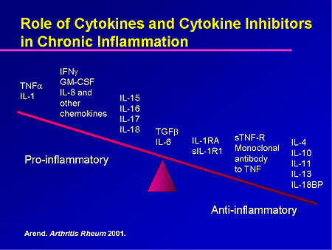

Slide 25
1997
2005
2006
Effects of selective H.E.L.P. LDL-apheresis on plasma inflammatory markers concentration in severe dyslipidemia: implication for anti-inflammatory response
Zenti MG & Stefanutti C Cytokine (2011) 56(3): 842-9 (Review article)

Slide 26


Background
In two different investigations, we examined the changes in plasma pro- and anti-inflammatory cytokine levels in patients with FH and/or HyperLp(a), with pre-existing angiographically demonstrated CHD, and AVD, after three consecutive sessions of LDL-apheresis.
Cytokines profile in serum of homozygous familial hypercholesterolemia is changed by LDL-apheresis.
Stefanutti C, Vivenzio A, Di Giacomo S, Ferraro PM
Cytokine (2011) 55: 245–250
Apheresis-inducible cytokine pattern change in severe, genetic dyslipidemias
Stefanutti C, Vivenzio A, Ferraro PM, Morozzi C, Belotherkovsky D
Cytokine (2011) 56(3): 835-41

Slide 27
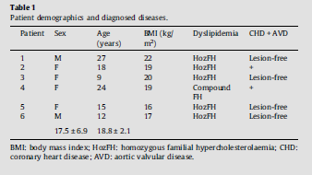
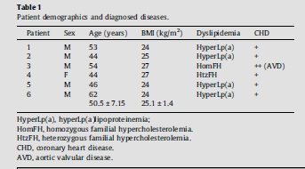
Patient demographics and diagnosed diseases
1° experiment
2° experiment
7 measurements /each parameter/ single individual (US-based Lab)
Notes:
27

Slide 28
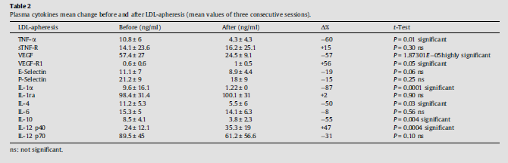
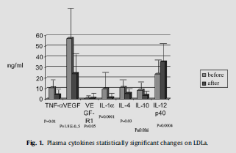
Results
1° experiment
Notes:
28

Slide 29
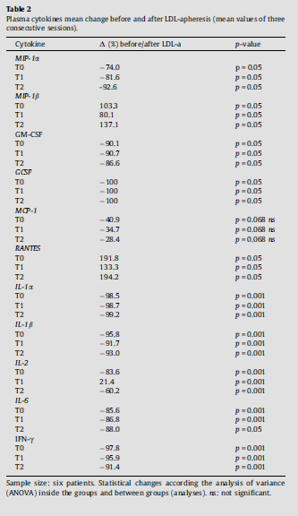
Results
2° experiment

Slide 30
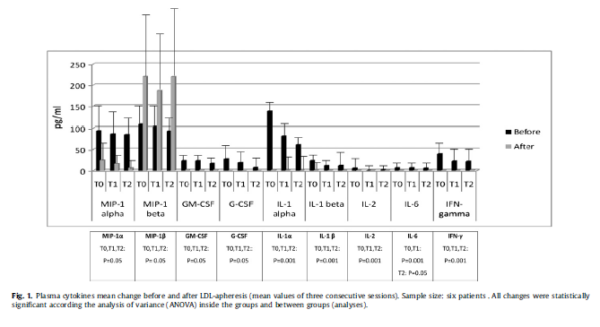
Results
2° experiment
MIP-1α was significantly reduced, while MIP-1β was significantly increased. MCP-1 was reduced (ns), while RANTES was significantly increased. GCSF and GM-CSF were significantly reduced. IL-1α was significantly reduced. IL-1β, IL-6, and IFN-γ levels were significantly reduced. IL-2 level in plasma was significantly reduced at T0, and T2, and statistically significant increased at T1.
Notes:
30

Slide 31
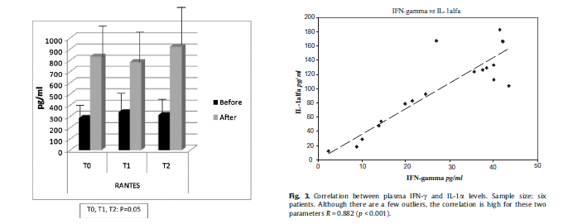

Results
2° experiment
A significant correlation between IFNγ and IL-1α . Although there are a few outliers, the correlation is pretty good for these two analytes R = 0.882 (p<0.001).

Slide 32

LDL-APHERESIS EFFECTS ON INFLAMMATORY RESPONSE IN PATIENTS WITH SEVERE DYSLIPIDEMIA AND CORONARY ARTERY DISEASE
Aim of the project
To evaluate if D.A.LI. LDL-apheresis is able at inducing significant changes in plasma cytokine and related receptor profile, meanwhile assessing mRNA expression for IL-1α, IL-6, IFN-γ, TNF-α and the endothelial damage marker PTX3 in patients with severe genetically determined determined Dyslipidemia - FH, Hyper-Lp(a)lipoproteinemia [HyperLp(a)] -, and associated CAD, an open-label study will be carried out.

Slide 33
Effetti della LDL-aferesi
Riduzione delle LDL-C, LDL-Ox, VLDL-C, Lp(a) e dei fattori della coagulazione
Riduzione della viscosità plasmatica e della aggregazione eritrocitaria
Riduzione delle molecole di adesione
Aumento della disponibilità di NO e miglioramento della funzione endoteliale
Ritardo della progressione delle lesioni coronariche dimostrato
angiograficamente
Riduzione della area della placca ATS e del volume delle placche
calcificate
Aumento della riserva coronarica
Riduzione dello IMT nei vasi epiaortici (carotidi)
Riduzione della mortalità cardiaca e degli eventi coronarici

Slide 34
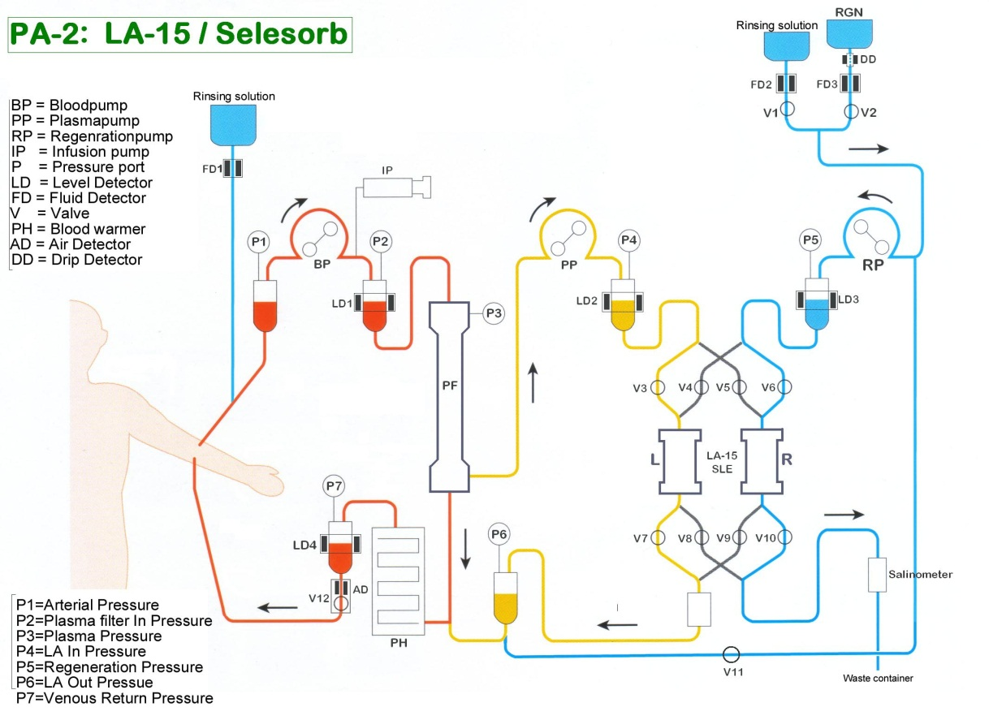
Therapeutic Plasmapheresis in the Treatment of Complicated Systemic Lupus Erythematosus
Stefanutti C., et al (2008): Therapeutic plasmapheresis in the treatment of complicated Systemic Lupus Erythematosus. In:
“Systemic Lupus Erythematosus Research Trends.” Editor: Thomas I. Seward pp. 1-8 Pub. Date: 2008 - 1st Quarter Pages: 260 pp. ISBN: 1-60021-861-x. Frank Columbus Ed. Nova Science Publishers, Inc. New York, U.S.A..
6 patients, 5 females and 1 male, (mean age: 39.5 years) with SLE, submitted to therapeutic plasmapheresis using Selesorb® immunoadsorption system

Slide 35
Patient PE affected by SLE:
Progressive decrease of proteinuria (g/24 hours)
after 1-year treatment with immunodsorption apheresis
C. Stefanutti et al, 2008

Slide 36
Immunoadsorption Apheresis and Immunosuppressive
Drug Therapy in the Treatment of Complicated
HCV-Related Cryoglobulinemia
C. Stefanutti,1* A. Vivenzio,1 S. Di Giacomo,1 G. Labbadia,1 F. Mazza,1
G. D'Alessandri,2 P.M. Ferraro,3 and C. Masala 1
1Department of Clinical and Medical Therapy, Plasmapheresis Unit, University of Rome
‘La Sapienza’, Policlinico ‘Umberto I’ Rome, Rome, Italy
2U.O. Immunohematology, P.O. ASL 3, Pistoia, Italy
3Renal Unit, Catholic University of the Sacred Heart of Rome, Vatican City, Rome, Italy
J Clin Apher. 2009;24(6):241-6. PMID: 19927363

Slide 37
Study design and course of treatment
All patients after “run in “ period were assigned randomly in
Group A : Patients submitted to IA Apheresis plus drug
Group B: Patients submitted to medical therapy only
24 weeks study duration
12 weeks
12 weeks
IDT only
IA Apheresis
plus IDT

Slide 38
Clinical Score (CS)
At baseline CS0 | Patients enrollment in the study
After ‘run-in’ CS1 | After 12 weeks treatment with IDT
End of the study | After 24 weeks: Group A: IA + IDT (CSA) Group B: IDT only (CSB)

Slide 39
Clinical Score.
Statistical differences observed in the study
CS0 | 21.44 ±1.8
CS1 | 22.13±1.9 | ns
CS1 | 22.13±1.9
CSA | 10.0±0.7 | P<0.001
CSB | 12.1±2.2 | ns
CSA | 10.0±0.7 | P= 0.03
CSB | 12.1±2.2

Slide 40
Outcome
Variazioni statisticamente significative rilevate: tra CSA e CS1 (p≤0.001) e tra CSA e CSB (p=0.03). Le variazioni risultavano essere più favorevoli al gruppo (A: IA + IDT) randomizzato al trattamento combinato farmacologico-aferetico;
E’ stata infatti osservata una percentuale statisticamente significativa più elevata di remissione delle tre più severe complicanze cliniche censite nello scoring model (ulcere degli arti inferiori, vasculiti ed ulcere cutanee con necrosi) nel gruppo A in confronto al gruppo B (80% vs 33%, rispettivamente) (p ≤ 0.05).
Studio citato da guidelines ASFA 2010 per l’indicazione specifica

