Slide 1

Severe hyperchylomicronaemia and hypertriglyceridaemia: why, when and how it is to be treated
Claudia Stefanutti, Roma, Italia, Europa
3rd Dresden International Symposium on Therapeutic Apheresis
March 13 – 15, 2014

Slide 2
WHY

Slide 3
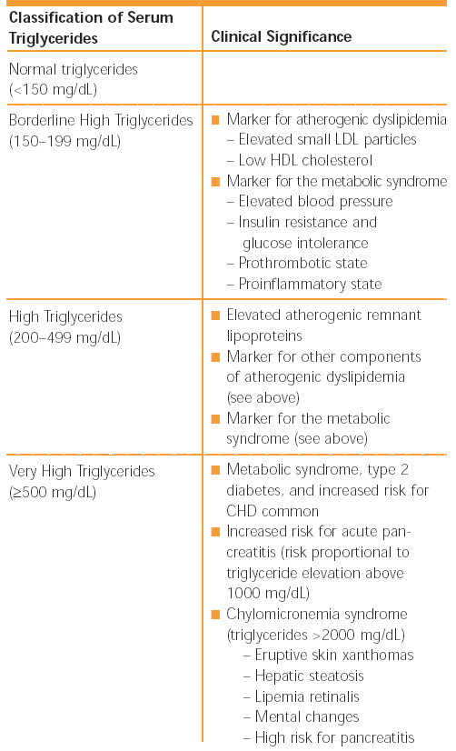
ATP III
2001-2004

Slide 4
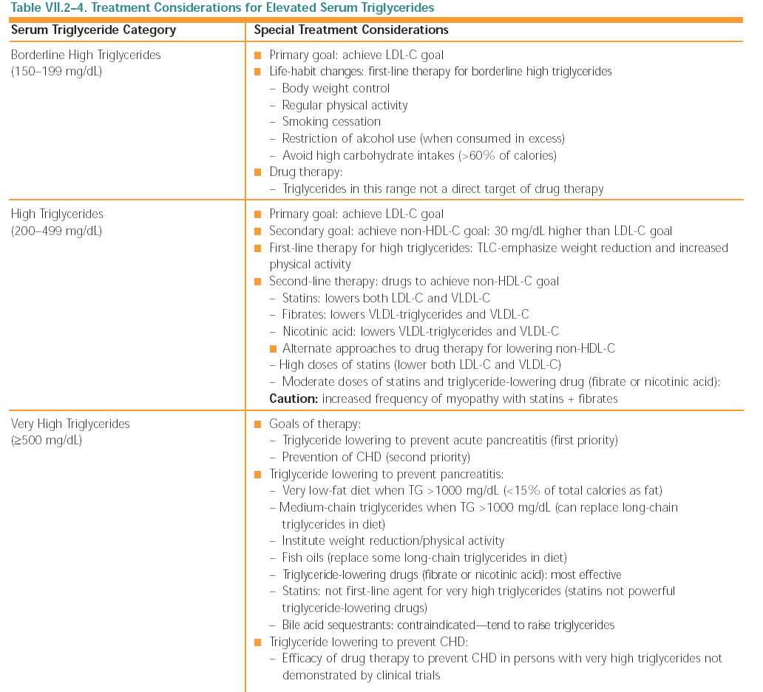
ATP III 2001-2004

Slide 5
ESC/EAS
About 1/3 of adults in Europe have TGs >1.7 mmol/L (151 mg/dL) with or without low HDL-C. Even with well controlled LDL-C levels, these people are at high CV risk and non-HDL-C or apo B are recommended as secondary targets in this group.
One of the major clinical risks of dramatically elevated TG is AP. The risk of AP is clinically significant if TG exceed 10 mmol/L (more than ∼880 mg/dL) and actions to prevent AP are mandatory. Notably HTG is the cause of ∼10% of all cases with AP, and patients can develop AP even when their TG concentration is between 5 and 10 mmol/L (∼440–880 mg/dL).
Atherosclerosis. 2011 Jul;217(1):3-46.
ESC/EAS Guidelines for the management of dyslipidaemias The Task Force for the management of dyslipidaemias of the European Society of Cardiology (ESC) and the European Atherosclerosis Society (EAS).
Catapano AL1, Reiner Z, De Backer G, Graham I, Taskinen MR, Wiklund O, Agewall S, Alegria E, Chapman M, Durrington P, Erdine S, Halcox J, Hobbs R, Kjekshus J, Filardi PP, Riccardi G, Storey RF, Wood D; European Society of Cardiology (ESC); European Atherosclerosis Society (EAS).

Slide 6
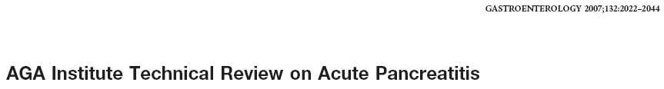
Hypertriglyceridemia is associated with acute pancreatitis, both as an etiology and as a consequence. Hypertriglyceridemia occurs in about 20% of patients with acute pancreatitis.
Close control of blood glucose levels is also needed to facilitate control of serum triglyceride levels.”

Slide 7
Triggering mechanism
Lithiasis Alchool/Drugs Microbes ERCP/Trauma
Initial injury
Ischaemia Duct obstruction Activation of zymogen
hours
Cytokines Production
(TNFα, IL-1, IL-6, IL-8, PAF)
Vasoactive molecules release
Release of activated enzymes
Pancreatitis
Inflammation
Vascular damage
Ischaemia
1° week
Tissue damage
Cell Necrosis
Necrosis
Microcircle impairment
Macrophages Activation
PMN
2° week
Necrosis Progression
Complications
3- 4 weeks
Superimposed Infection

Slide 8
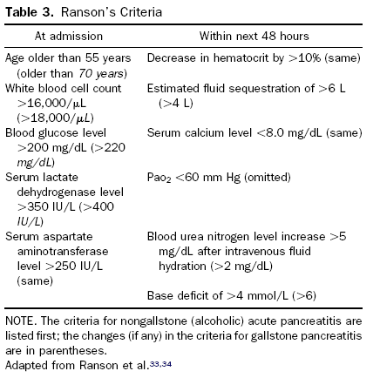
Severity criteria
Prognostic signs

Slide 9

SEVERE
HYPERTRIGLYCERIDAEMIA
➢Serum TG levels above 1,000-2,000 mg / dL are usually considered necessary to ascribe causation for AP.
➢ Hypertriglyceridaemia is reported to cause 1 – 4 % AP episodes
➢ Chylomicron remnants or intermediate
density lipoprotein-like particles
and/or
➢ Chylomicrons

Slide 10
➢ The mechanism for hypertriglyceridaemic
pancreatitis is postulated to involve hydrolysis of
TG by pancreatic lipase and release of free fatty
acids that induce free radical damage
sHTG is the most common etiology of AP next to alcohol and gallstone-induced disease
sHTG was listed as causative in 56% of gestational pancreatitis cases in one study

Slide 11
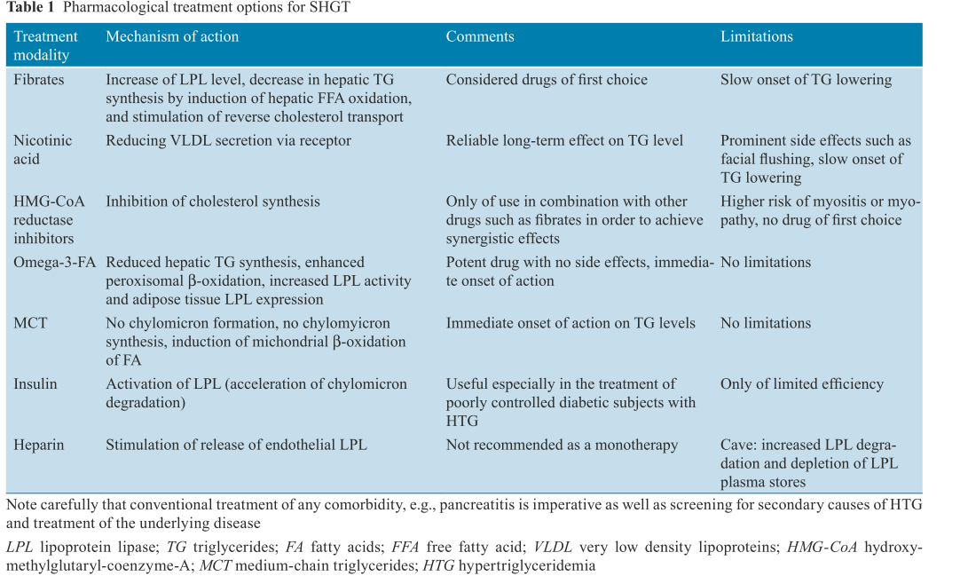
Ewald N, Kloer HU. Clin Res Cardiol Suppl 2012

Slide 12
WHEN
Type of quantitative and qualitative lipid and lipoprotein disorder
Timing of extracorporeal intervention

Slide 13
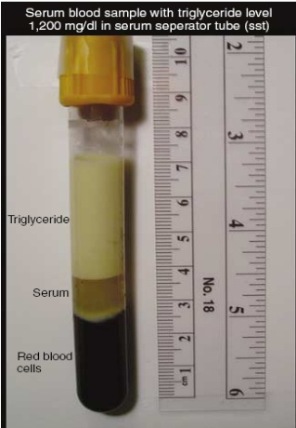
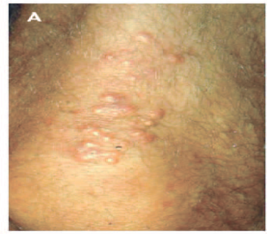
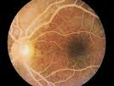
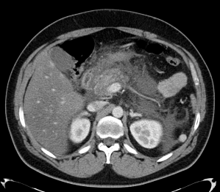
CHYLOMICRONAEMIA
SYNDROME
➢ Eruptive xanthoma:small yellowish papules,
frequently with an erythematous base, appearing predominantly on the buttocks or extremities
➢ Lipemia retinalis: the retina has a salmon-colored, creamy appearance, and the retinal vessels are white
➢ Abdominal findings: abdominal pain, acute
pancreatitis, and/or hepatosplenomegaly

Slide 14
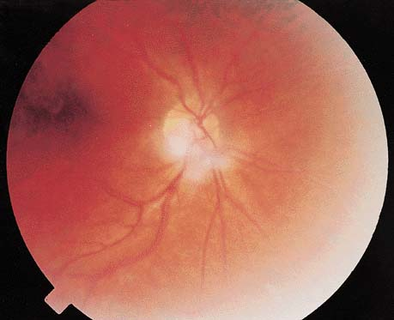
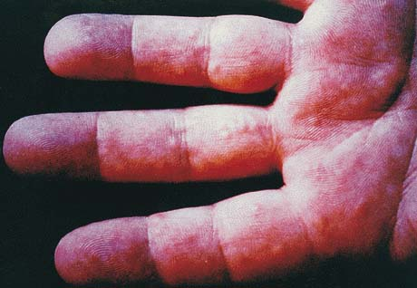
Lipemia retinalis
Eruptive Xanthomatosis

Slide 15
Broad β (remnant disease) type III hyperlipoproteinemia
CML, F, 65 yrs
Stefanutti C., personal data, 1990

Slide 16
BM ♀, 45 yrs on treatment by plasma-exchange
stop & go
Stefanutti C, personal data, 2005
Notes:
C

Slide 17
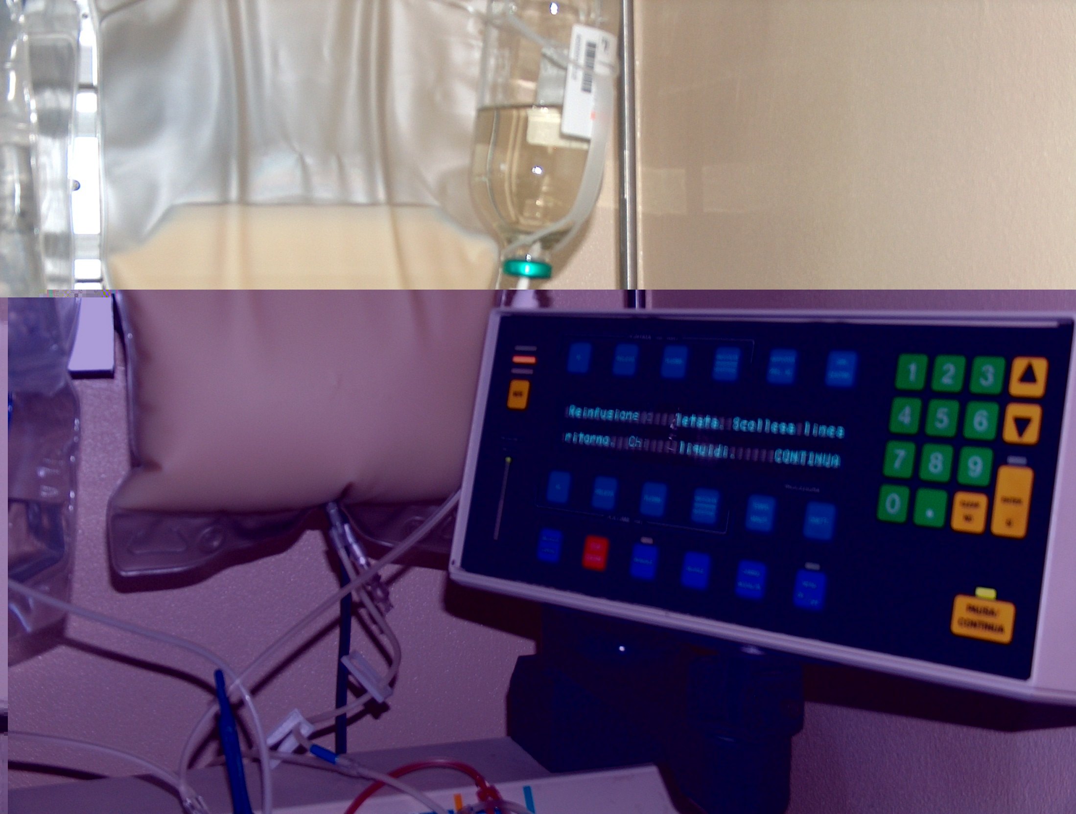
BM ♀, 45 yrs. under plasma-exchange.
Detail of the waste bag
Stefanutti C., personal data, 2005

Slide 18

A three month-old infant with severe hyperchylomicronemia: molecular diagnosis and extracorporeal treatment
Stefanutti C, Gozzer M, Pisciotta L, D'Eufemia P, Bosco G, Morozzi C, Papadia F, Shafii M, Di Giacomo S, Bertolini S.
Atheroscler Suppl. 2013 Jan;14(1):73-6. doi: 10.1016/j.atherosclerosissup.2012.10.020.PMID:23357145
University of Rome ‘Sapienza’, Department of Molecular Medicine Extracorporeal Therapeutic Techniques Unit Immunohematology and Transfusion Medicine
Department of Internal Medicine, University of Genoa
D.A.I. Pediatrics and Infant Neuropsychiatry
Unit of Metabolic-Genetic Diseases, Pediatric Hospital Giovanni XXIII, Bari, Italy

Slide 19
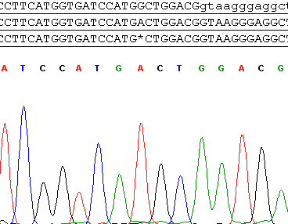
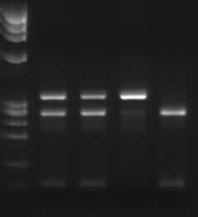
A
B
LPL gene exon 2
c.242G>A, p.G81D
Nco I digestion
MW F M P W
-326 bp
-254 bp
-72 bp
supplementary Figure 1

Slide 20
Stefanutti C et al.:Atheroscler Suppl. 2013 Jan;14(1):73-6
I 1 2
1.78 mmol/L
1.08 mmol/L
II 1 2
359.5 mmol/L
0.90 mmol/L
LPL c.242G>A (p.G81D)
The proband was homozygous for a novel LPL mutation c.242G>A, p.G81D
Figure 1

Slide 21
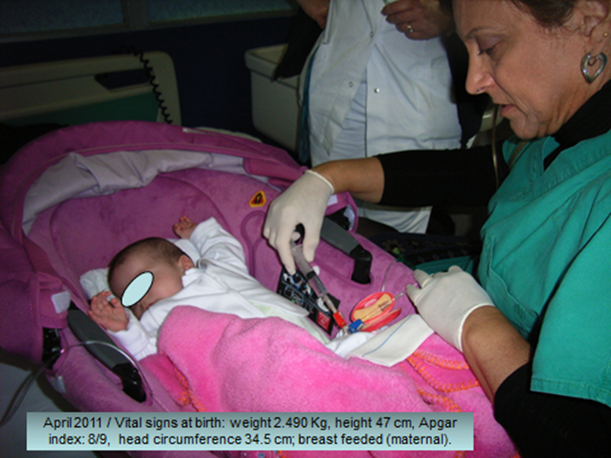
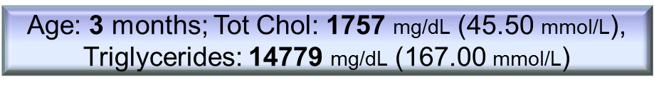
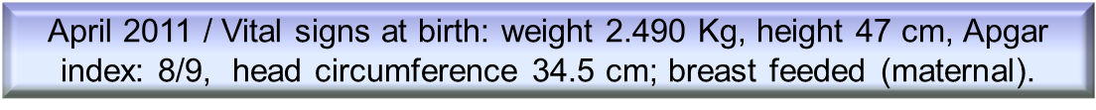

Slide 22
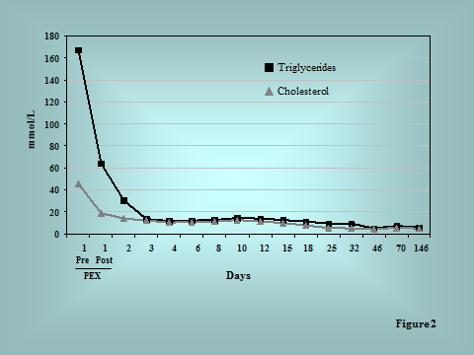


Slide 23
Therapeutic apheresis in low weight patients: technical feasibility, tolerance,
compliance, and risks.
Stefanutti C., Isacchi G. et al., Transfusion and Apheresis Science, 31: 3-10, 2004

Slide 24
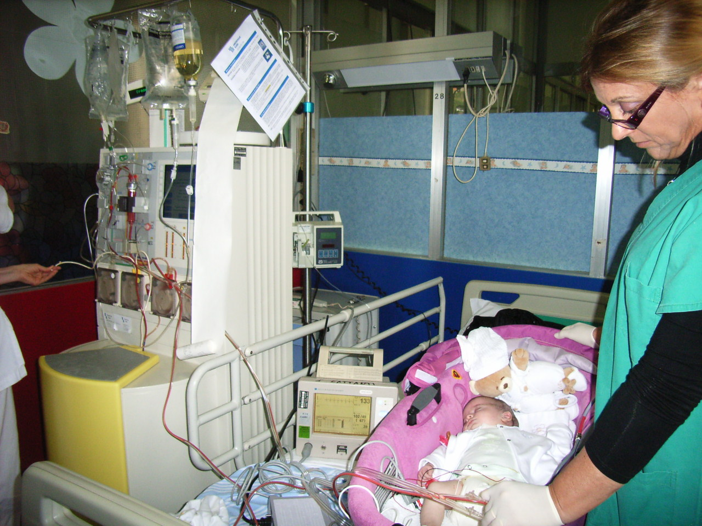

Slide 25
Case report 2
Methods
A/C = Heparin (30 UI/Kg)
ACD-A : Blood = 1 : 30
ACD utilized = 46 ml
Blood flow = 15 ml/min
Exchanged plasma volume:
1200 ml
Treatment duration = 90 min
Male aged 25 days
Body weight: 3,9 Kg
Height: 56 cm
Primary Hyperlipidemia (lipoprotein phenotype I)
Triglycerides: 38000 mg/dl
Cholesterol: 1200 mg/dl
Outcome: after only 1 procedure, triglyceridemia = 115 mg/dL,
Cholesterolemia = 200 mg/dL (the day after)
Stefanutti C., Isacchi G. et al., Transfusion and Apheresis Science, 31: 3-10, 2004

Slide 26
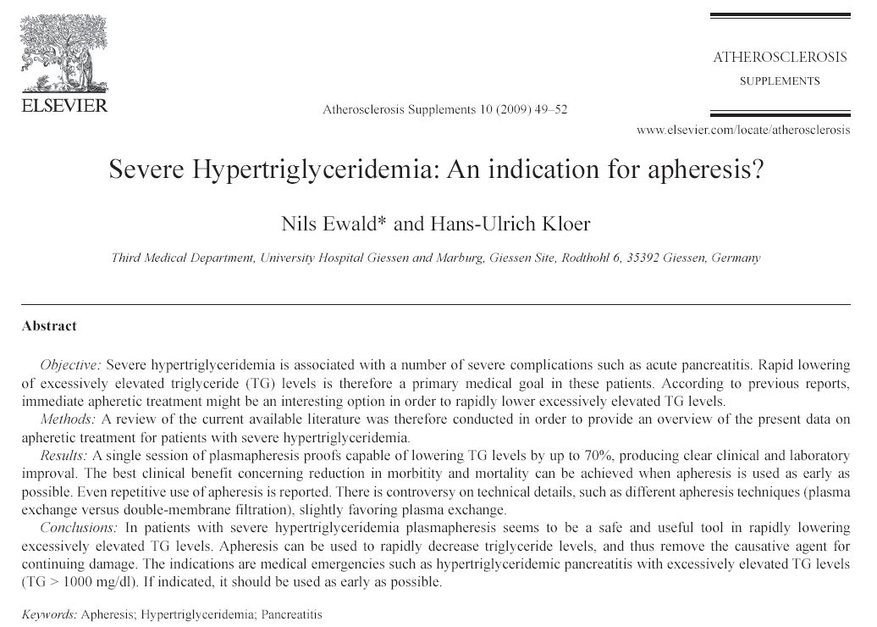

Slide 27
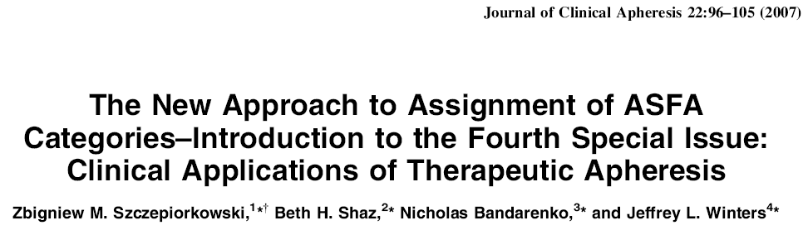
Clinical Indications
Metabolic Diseases | Type of Apheresis | ASFA 2007 | ASFA 2000
Insufficienza Epatica acuta | PEX | III | III
Ipercolesterolemia familiare omozigote | Rimozione selettiva | I | I
Ipercolesterolemia familiare eterozigote | Rimozione selettiva PEX | II II | I II
Hypertriglyceridemic Pancreatitis | PEX | III | NC
Avvelenamenti da funghi | PEX | II | III
Avvelenamenti da altre sostanze | PEX | III | III
Morbo di Refsum | PEX | II | I
Tireotossicosi | PEX | III | NC
Sepsi | PEX | III | NC

Slide 28
Primary causes: mutations in genes encoding for LPL and ApoCII
(Extreme TG elevation in Homozygous)
Secondary causes: Diabetes Mellitus, Hypothyroidism, Pregnancy, Medications
Acute pancreatitis: Triglyceride level > 2.000 mg/dL

Slide 29
Apheresis in hypertriglyceridemic pancreatitis
(reports with five or more patients)
Study | N. patients | N. patients with complete recovery (%) | Mortality (%)
Chen et al. (Word J Gastroenterol 2004) | 20 | 20 (100) | 0
Yeh et al. (J Clin Apher 2003) | 17 | 13 (76.5) | 2 (11.8)
Kyriakidis et al. (Digestion 2006) | 10 | 9 (90) | 1 (10)
Kadikoylu et al. (Transfus Apher Sci 2006) | 7 | 7 (100) | 0
Lennertz et al. (Ther Apher 1999) | 5 | 5 (100) | 0
Tsuang W et al. Am J Gastroenterol 2009;104:984-991

Slide 30
According to data of Lennertz et al. and Yeh et al., a single session of plasmapheresis is able of drammatically lowering TG levels by up to 70% , producing clear clinical and laboratory improvement of acute pancreatitis.

Slide 31
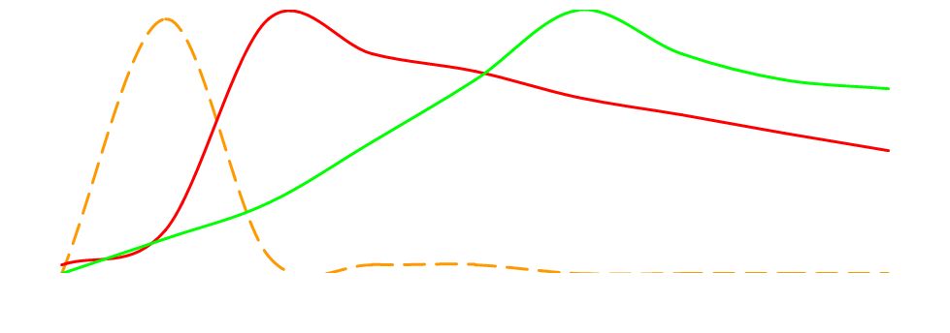
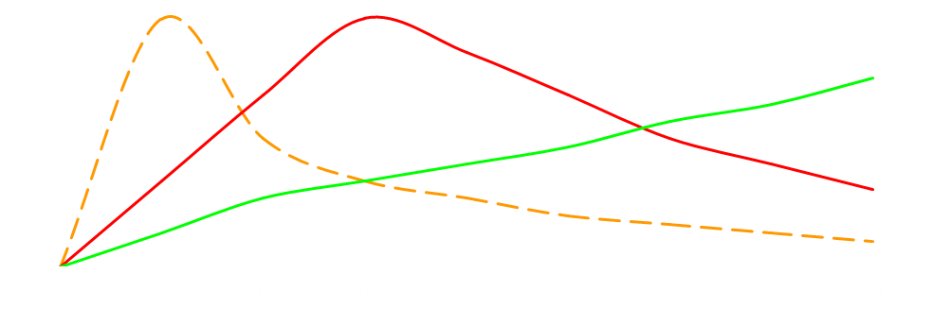
Evolution of Acute Pancreatitis:
Organ failure and Inflammation Mediators
Pain insurgence
Organ Dysfunction
Cytokines Synthesis
Admission to Emergency Unit
Window of opportunity
for treatment
TAP
IL-6
PCR
TAP = trypsinogen activating peptide
Plasma levels

Slide 32
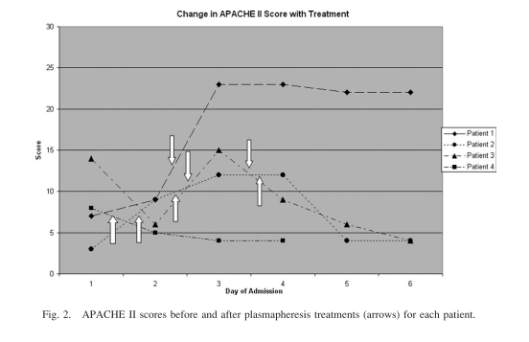
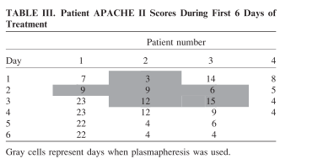
Plasmapheresis in the treatment of hypertriglyceridaemia-induced pancreatitis: A community hospital's experience
Syed H, et al. J Clin Apher. 2010;25:229-34.

Slide 33
There was no clear relationship between the use of TPE and either improvement in APACHE II scores, lenght of ICU stay, lenght of total hospital stay, or prevention of complications secondary to severe pancreatitis
TPE was successful in lowering TG levels (significant reductions in TG levels)
No negative clinical effects attributed to TPE
Reccomend using plasmapheresis within the first 24 hr of presentation
Syed H, et al. J Clin Apher. 2010;25:229-34

Slide 34
PEX, performed within 48 hours lowers lipids and triglyceride-rich-lipoproteins quickly, meanwhile improving GI symptoms (upper abdominal pain in particular. Follow-up (4-54 months): no recurrence of AP

Slide 35
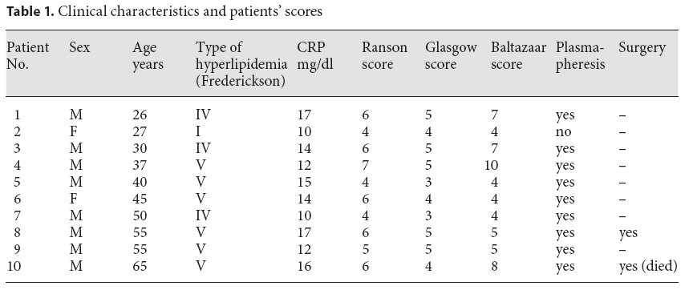
9 patients who did not respond to the standard therapy were treated within 48 hours by PEX utilizing FFP as replacement fluid;
7 patients were submitted to a single procedure

Slide 36
Timing clinical events in the treatment of pancreatitis and hypertriglyceridemia with therapeutic plasmapheresis
Stefanutti C, Di Giacomo S, Labbadia G.
Transfus Apher Sci. 2011 Aug;45(1):3-7. doi: 10.1016/j.transci.2011.06.013. Epub 2011 Jul 1
University of Rome ‘Sapienza’, Department of Molecular Medicine Extracorporeal Therapeutic Techniques Unit Immunohematology and Transfusion Medicine
Department of Internal Medicine and Medical Specialties

Slide 37
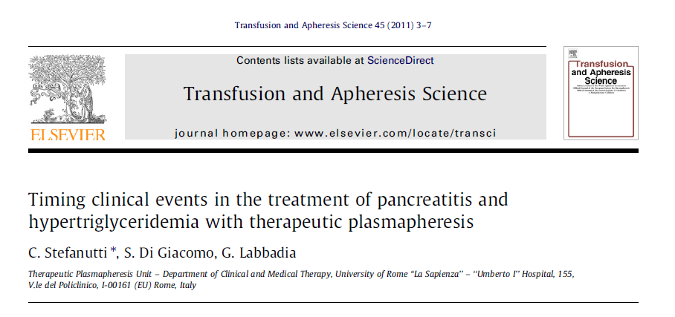

Slide 38
Described is the timing of clinical events and the sequence of therapeutic plasma-exchange (TPE) procedures to treat pancreatitis due to SHTG
Male patient, Caucasian, 49 years, referred to emergency for severe epigastric pain
No history of alcohol consumption, nor diabetes, a pre-existing mild hyperlipidemia was treated with diet alone, and biliary imaging was normal (by ultrasound)
Laboratory: revealed marked hypertriglyceridemia (11,355 mg/dL), and hypercholesterolemia (941 mg/dL). Serum amylase and lipase were increased: 160 UI/L (range: 20–100) and 175 UI/L (range:13–60), respectively
A CT scan of the abdomen revealed a picture compatible with acute pancreatic phlogosis. It was diagnosed as ‘‘acute AP and SHTG’’.
Results: The patient was successfully submitted to 3 sessions of TPE in emergency. Released from hospital after 13 days of hospitalization.
TG 185 mg/dL; TC 179 mg/dL; HDLC 22 mg/dL; LDLC 120 mg/dL.

Slide 40
HOW

Slide 41
Ewald N, Kloer HU. Clin Res Cardiol Suppl 2012

Slide 42
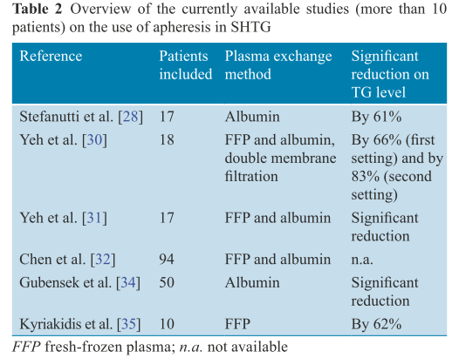
Ewald N, Kloer HU. Clin Res Cardiol Suppl 2012

Slide 43
Plasmapheresis could be very useful in reducing TG levels during the acute phase of AP or in the prevention of recurrent AP.
Plasmapheresis has two beneficial modes of action:
TG are removed with the plasma of the patient and LPL and Apo C-II are provided at the same time with the fresh frozen plasma of the healthy donor.
The use of albumin (and saline) in plasmapheresis is an alternative

Slide 44
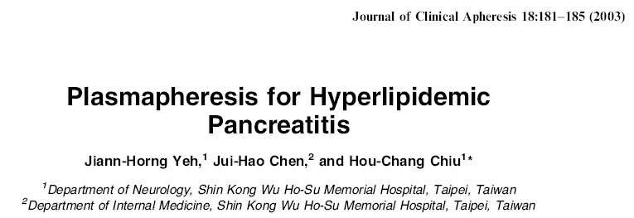
17 patients with HLP treated by plasmaexchange:
  complete recovery in 13 patients (76,5%)
  2 patients developed local complications
  2 patients died
10 patients treated on single session basis, 7 had 2 sessions
8 patients had FFP, 9 albumin + saline

Slide 45
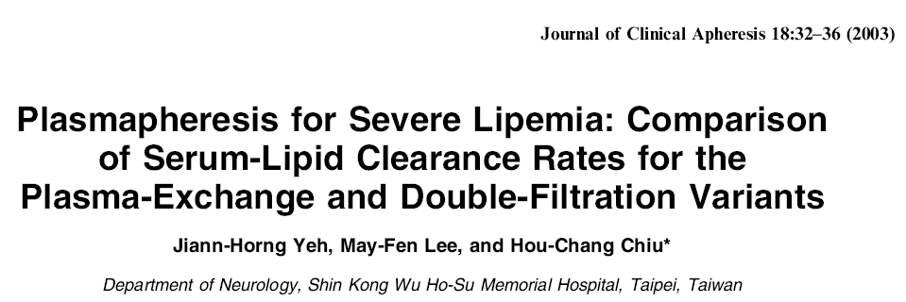
18 patients with severe Hyperlipidemia (12 treated by PEX, 6 by CF)
Complications: hemolysis in 3 patients under PEX (25%), in 5 under DF (83%)
(% removal of TG-rich particles was lower in those treated by CF)
Hypertriglyceridemia was associated to the increase in VLDL (∅ 30-80 nm) and Chylomycrons ( ∅ 2000 nm)
Chylomycrons may alter the particles removal efficiency of plasma filter membrane
( ∅ plasma filter pores are approximately 200-300 nm).
Lennerz (1999) infused an heparin bolus IV (50 IU/Kg) before-apheresis to promote the clearance of TG and induce the release of LPL from endothelium

Slide 46
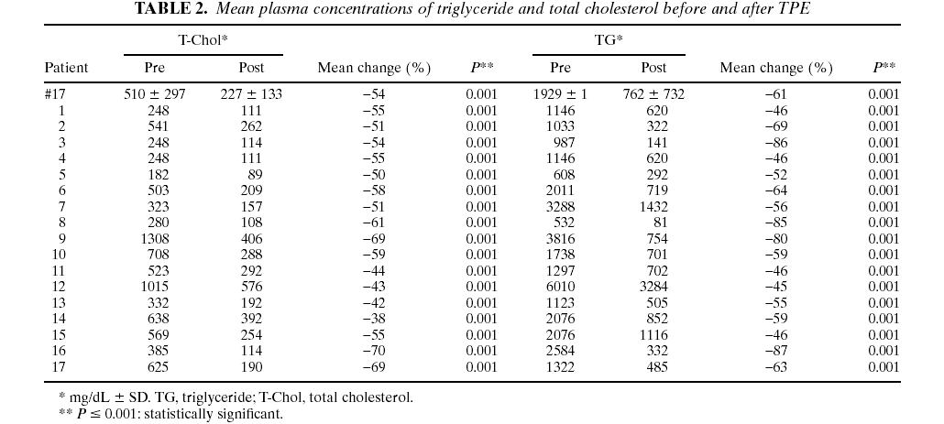

Stefanutti C et al. Artif Organs. 2009;33:1096-102

Slide 47
Table 1. Patient demographics and clinical characteristics
* Years ± SD
** body mass index (kg/cm²±SD)
AP: acute pancreatitis
CHD: coronary heart disease
GLYG: glycogenosis
AMY: amyloidosis
ARI: acute renal insufficiencycy
PEX within 48 hours in emergency; # 6 on long-term treatment with PEX; 12 had AP; # of sessions: range 1-46; No deaths
Stefanutti C et al, 2009; Artificial Organs 33(12):1096–1102

Slide 48
MEAN PLASMA CONCENTRATIONS OF TRIGLYCERIDE (TG) AND TOTAL CHOLESTEROL (T-CHOL) BEFORE AND AFTER TPE (PEX)
Lipid | Before TPE | After TPE | Mean Change (%) | p-level**
TG* | 1,929.15 ± 1,383.01 | 762.45 ± 732.38 | - 61.48 | 0.001
T-Chol* | 510.58 ± 297.34 | 227.58 ± 133.32 | - 54.65 | 0.001
* mg/dL ± SD
**p ≤ 0.001: statistically significant

Slide 49
PATIENT NO 5: EVIDENCE OF THE SYNERGISTIC EFFECTS ON TRIGLYCERIDE
LEVELS IN PLASMA COMBINING THE USUAL MEDICAL THERAPY WITH TPE (PEX)
Usual Medical Therapy
Usual Medical Therapy + TPE
Patient no 5 | TG (PRE) | TG (POST) | ∆% | p
UMT* | 1139,25±77,98 | 936±306,30 | -17,84 | n.s
UMT*+TPE | 394,83±119,90 | 230,83±62,17 | -41,53 | p<0,005
*Usual Medical Therapy TPE: Therapeutic Plasma-Exchange

Slide 50
In Summary
Hypertriglyceridemic Pancreatitis, Hyperchylomicronemia, PEX and CF
Start apheresis within 48 hours from the diagnosis
in the majority processing 1-1,5 plasma volume is enough
very often 1 procedure can obtain remittance
Plasmaexchange is superior to Cascade Filtration, seemingly because TG-rich particles (VLDL, betaVLDL, IDL) and Chylomycrons may induce clotting in the plasma filter
In selected cases FFP may be helpful as replacement fluid
(LPL and Apolipoproteins are in the FFP)
A bolus of heparin before apheresis may be very helpful as inducer of LPL release from endothelium
(not to be given in necrotic- hemorrhagic pancreatitis assessed by CT)
When all these pre conditions are taken into consideration PEX could be a reliable, safe and effective therapeutic techniques to treat refractory HTG and severe HLP

Slide 51
THOUGHTS and RECOMMENDATIONS
1) Clinicians should routinely test TG levels in patients who present with
AP to correctly identify the need for specialized management
2) A single session of plasmapheresis is able of drammatically lowering
TG levels by up to 70% and can reduce symptoms by 46%-80%
3) The effects of TPE on lowering the morbidity, mortality and lenght of stay of patients with HP is uncertain and warrants further investigation into its efficacy

Slide 52
THOUGHTS and RECOMMENDATIONS
4) The prognosis after TPE may be dependent on the timing of TPE
initiation
5) Apheresis should be started within 24-48h of HP diagnosis and
continued in several sessions until end-of-session serum TG levels
are <500 mg/dL
6) American Society for Apheresis Guidelines from 2010 gives TPE for
HTGP a category III (strength evidence level defined as type II-1; Grade of reccomendation 2C)

Slide 53
Severe hypertriglyceridemia-related acute pancreatitis
Stefanutti C, Labbadia G, Morozzi C.
Ther Apher Dial. 2013 Apr;17(2):130-7. doi: 10.1111/1744-9987.12008. Epub 2013 Feb 28. Review. PMID:23551669
Hypertriglyceridaemia, Postprandial Lipaemia and non-HDL cholesterol
Claudia Stefanutti, Giancarlo Labbadia *, Vasilios G. Athyros §
Current Pharmaceutical Design, 2014, in press

Slide 54

VENTOTENE Island – Central East Tyrrhenian Sea WP 42°47’,75 N 13°26’,17 E

